Slide 1
SOP PreScrap

Slide 2
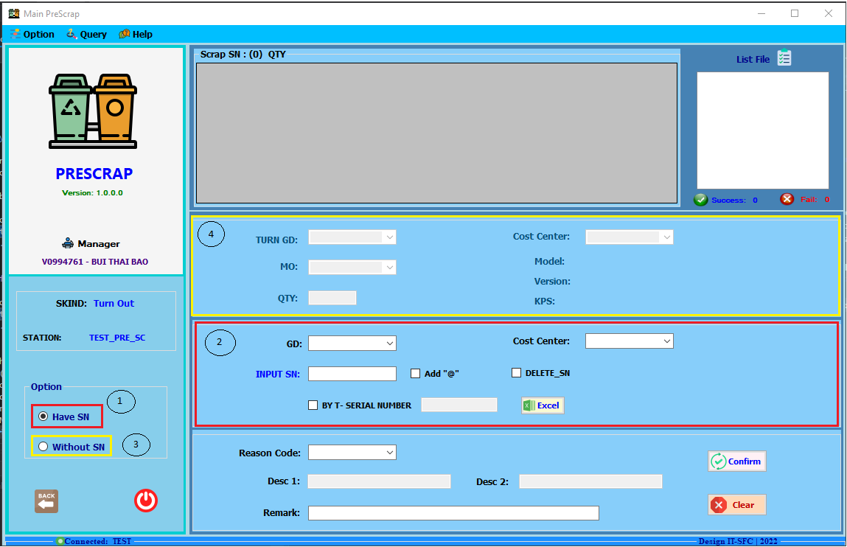
PreScrap
CHECK IN
1 – 2: Use in case have SN
3 – 4: Use in the absence of SN

Slide 3
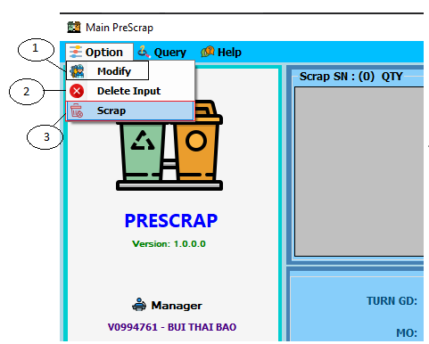
PreScrap
CHECK IN
CHECK OUT
Delete SN in List file
Backup data
Permisson: PRG_NAME = PRESCRAP, FUN = SCRAP

Slide 4
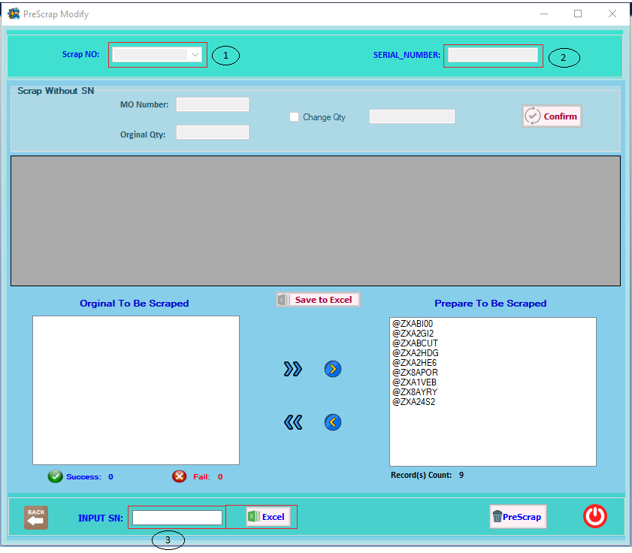
PreScrap
CHECK OUT
Search by code Scrap_No
Search Scrap_No by SN
Permisson: PRG_NAME = PRESCRAP, FUN = SCRAP_NO, PRIVILEGE = 2
3. Search SN directly or import list

